Slide 2
Introduction
Sign attendance sheet
Owner:
Jeff Ray – Project Engineer
SAWS Treatment & Recycle Engineering
Marc Ripley – Contract Administrator
SAWS Contracting

Slide 3
RFQ Schedule
Questions Due
February 20, 2014
Answers Posted
February 24, 2014
SAWS Board Award
May 2014
Proposals Due
February 28, 2014
Interviews
(if necessary)
March 2014
Notification
March 28, 2014

Slide 4
Point of Contact for Questions
Marc Ripley – Contract Administrator
Fax: 210-233-3136
E-Mail: mripley@saws.org
Contracting Department
2800 US HWY 281 N. San Antonio, TX 78212
Note: SAWS Project Managers and Engineers will not respond to any questions submitted by phone and / or email directly to them

Slide 5
Evaluation Criteria
Project Team Resumes and Experience in Similar Projects – 40 Points
Project Approach – 30 Points
QA / QC and Risk Management – 15 Points
SMWB Participation – 15 Points

Slide 6
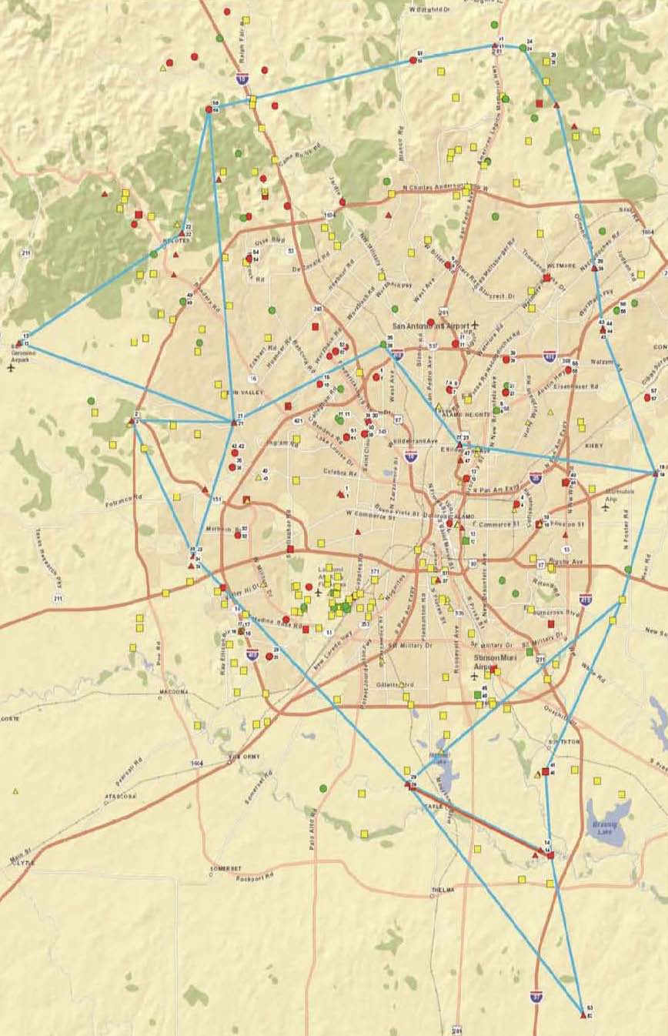
SAWS Facilities – Location Map
Legend
SAWS Facilities
Potential Potable Water Sites – This Phase 1 Project
Potential Potable Water Sites – Future Phase 2 Project
Other Sites – Not Part of Project
Other Sites – Not Part of Project

Slide 7
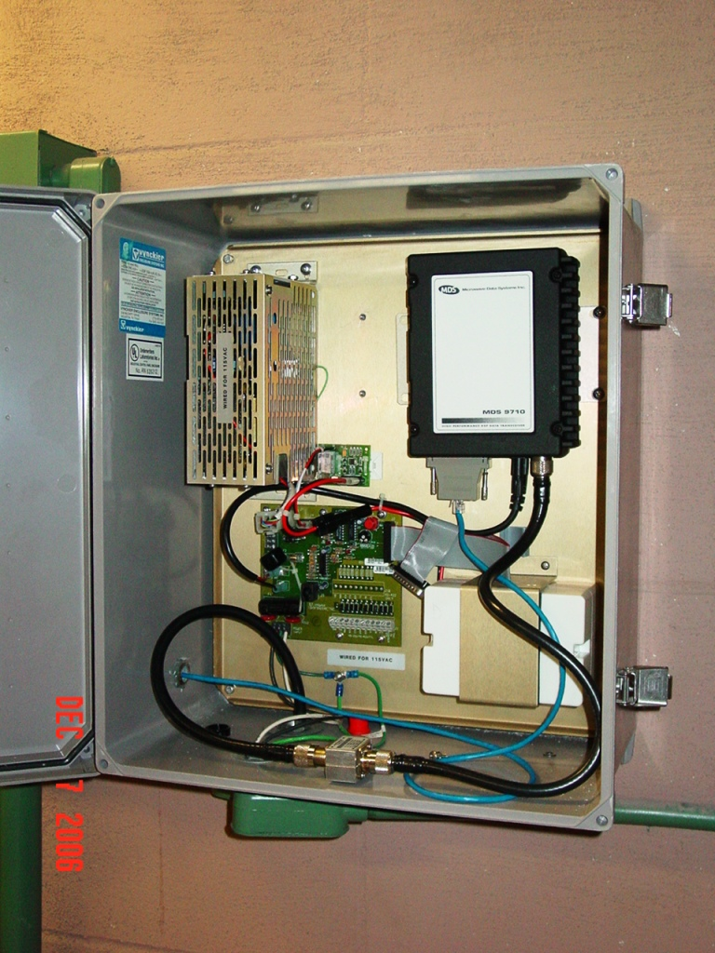
Production Site – Typical Radio Panel
Marbach PW Primary Pump Station

Slide 8
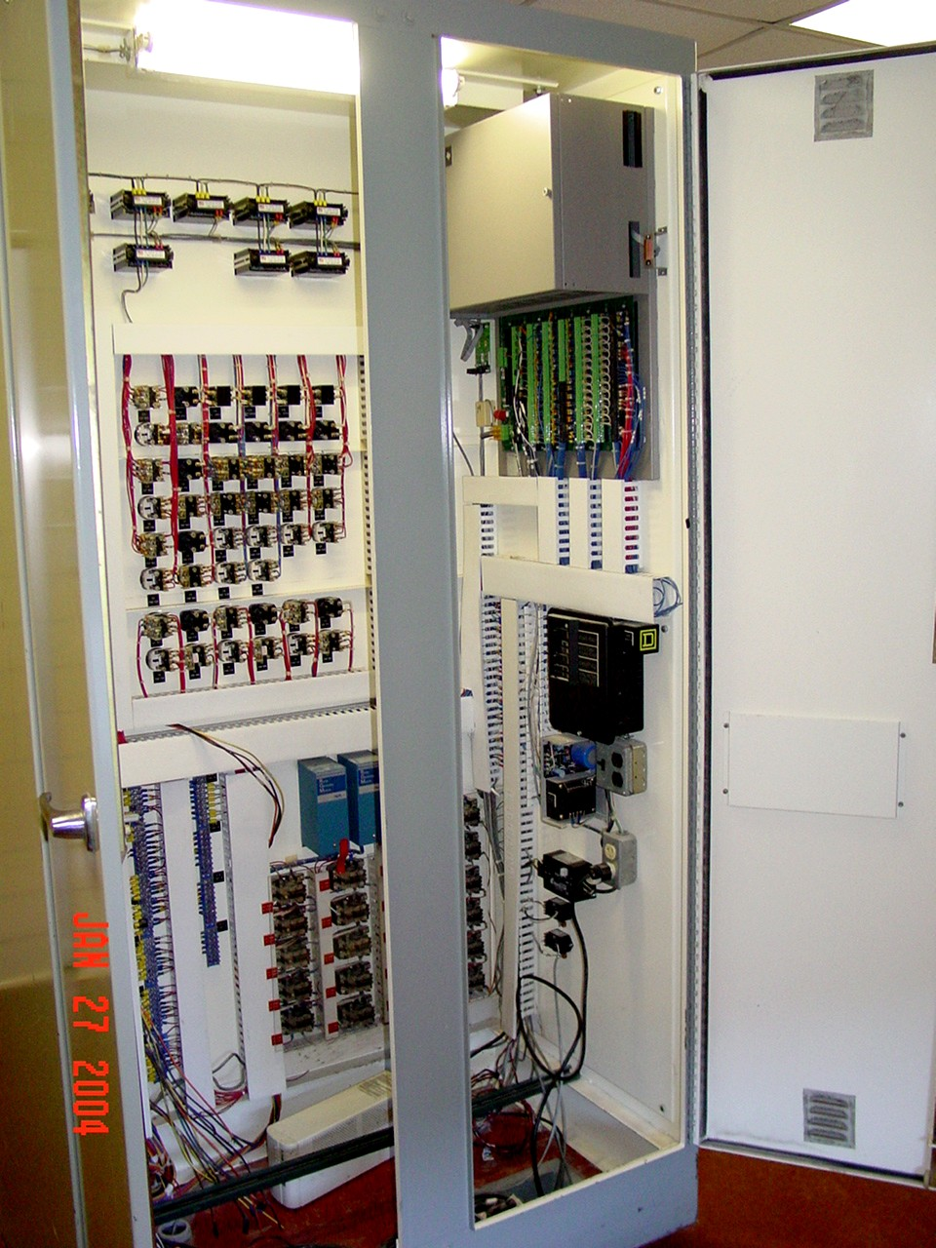
Production Site – Typical SCADA Panel
Commerce St. EMS – System Status Screen
Commerce St. EMS – Trend Screen
Market Street PW Primary Pump Station

Slide 9
Scope
Replace radio communication system w/ communication infrastructure that includes high speed, Ethernet IP radios, antennas, communication towers and backup power including emergency generators and / or uninterruptible power supplies
Evaluation of recently constructed broadband backhaul network for purpose of optimizing and interfacing new radio and PLC communications infrastructure to provide secure and reliable communications for approx. 100 existing primary water and booster pump stations and approximately 25 District Special Project (DSP) facilities

Slide 10
Scope, Cont.
Radio communication system will allow for future remote calibration of field monitoring and control equipment and reduction of time for signals to be received / transmitted for pump stations
Conduct radio path study for each site location, and field verify each site location for acceptable signal strength
Conduct radio path study to address and correct any issues, including, but not limited to, instances where signal strength is inadequate for proper operation of transmitting data across radio system
Conduct radio path studies that include investigation of redundant / alternate paths for each repeater site

Slide 11
Scope, Cont.
Replacement of radios and PLCs for approximately 100 primary water and booster pump stations, and SCADAPack controllers at approximately 25 District Special Project (DSP) facilities
Control Narrative and Performance Spec. may be required
Miscellaneous civil site and improvements work
Project upgrades to increase efficiency by developing standardized, automated control strategies for starting / stopping pumps based on equipment efficiency, customer demand patterns and energy costs, as well as allow for remote programming of PLCs

Slide 12
Questions

